Slide 1
Foundations: Geology
Core concepts, the rock cycle, and practical field identification

Slide 2
Geology Connects Time
Geology studies Earth’s materials, structures, processes, and history, linking observations to how the planet changes over time. It explains resources, such as granite for building stone, and hazards, like earthquakes along the San Andreas Fault. The Grand Canyon shows landscape evolution, with layered rocks recording environments and relative ages over millions of years.

Slide 3
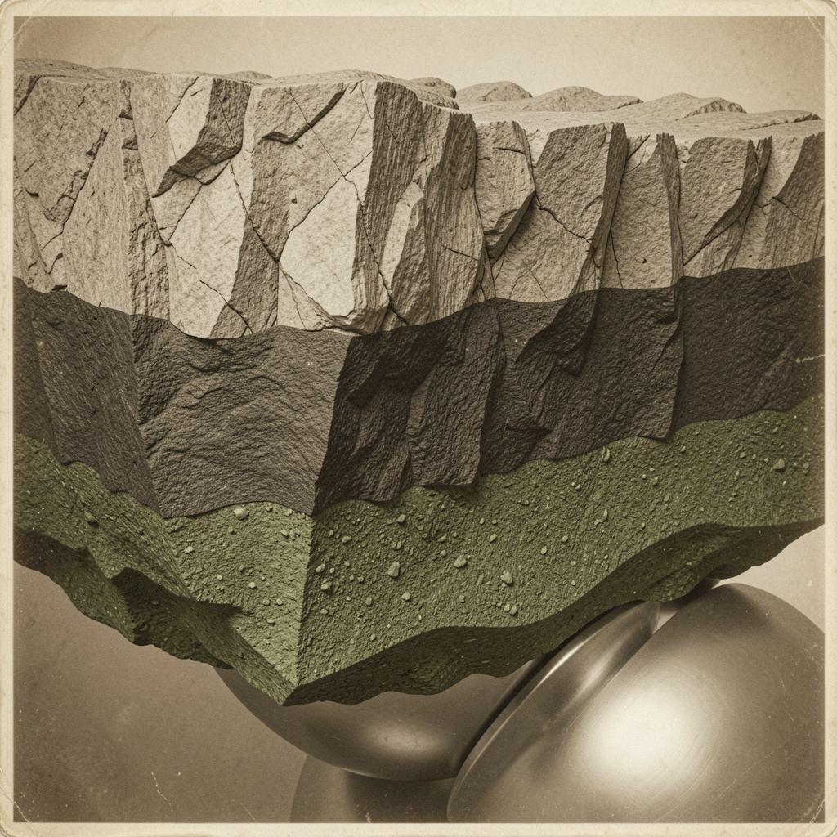
Layered Earth
Earth is organized into crust, mantle, and core, each with distinct composition and state that shape surface geology. Continental crust (~35 km) is silica-rich granite, while oceanic crust (~7 km) is basalt; both sit atop the mantle. The mantle (~2,900 km) is solid but convecting, dominated by peridotite and driving plate motion. The core comprises a liquid outer layer (~2,200 km) generating the磁;

Slide 4
Origins Separate Rocks
Forms when melt cools and crystallizes. Granite (intrusive, coarse-grained) vs basalt (extrusive, fine-grained) show texture tied to cooling history.
Sedimentary rocks form by deposition and lithification (e.g., sandstone, shale; fossils in limestone). Metamorphic rocks arise from heat and pressure altering existing rocks (e.g., schist with foliation; marble from limestone).
Rocks are classified by origin: igneous, sedimentary, or metamorphic.

Slide 5
Rock Cycle Steps
01
02
03
04
Melting
Cooling & Crystallization
Weathering
Erosion & Transport
Rocks melt to magma in subduction zones.
Magma solidifies to igneous rocks like granite or basalt.
Physical and chemical breakdown at the surface.
Water, wind, and ice move sediments to new sites.

Slide 6
Cycle Steps
Rocks melt to magma, typically in subduction zones or hot spots.
Melting
Magma cools and crystallizes into igneous rock (granite, basalt).
Cooling & Crystallization
Physical and chemical breakdown at the surface (freeze–thaw, dissolution).
Weathering
Water, wind, or ice move debris to new locations (rivers to deltas).
Erosion & Transport

Slide 7
Tectonic Drive
Plate tectonics orders crustal processes: convergence, divergence, and transform motion sculpt mountains, basins, volcanic arcs, and new oceanic crust. Convergent boundaries collide, producing orogens and regional metamorphism (Himalayas). Divergent margins form mid-ocean ridges and basaltic crust, while transform zones (San Andreas) accommodate lateral slip and earthquakes. Subduction zones share

Slide 8
Field Workflow
Contextual observation
Macroscopic description
Simple tests
Preliminary classification
Record & sample
Note location, outcrop orientation, layering, and how the unit relates to nearby rocks.
Record color, grain size, texture (coarse vs fine), and presence of fossils or foliation.
Hardness (scratch with knife), carbonate reaction (drop dilute HCl), magnetism (magnet), and streak.
Assign to igneous, sedimentary, or metamorphic using traits and tests (e.g., carbonate reaction + granular texture → limestone).
Photograph with scale, label samples with GPS and stratigraphic position, and note interpretation (e.g., “shallow marine limestone, fossil-rich, likely Paleozoic”). Worked example: coarse-grained, in-

Slide 9
Foundations Solidified
You can describe Earth’s internal layers and their physical properties. You can distinguish igneous, sedimentary, and metamorphic rocks with concrete examples. You can trace the rock cycle and follow a reproducible field workflow to observe, test, and identify samples.

Slide 10
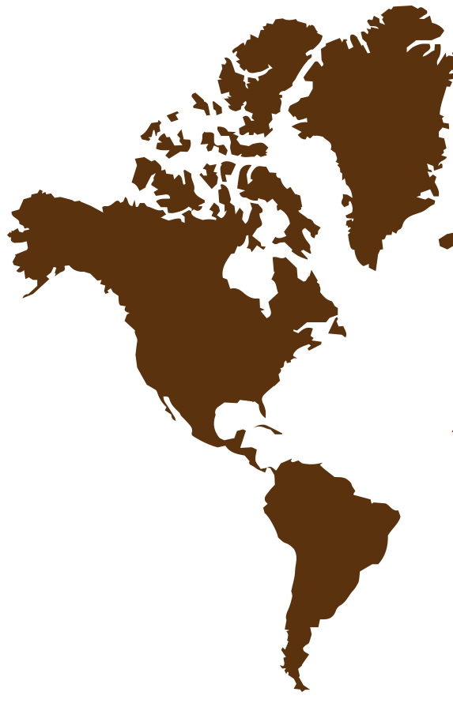
Thanks!
Does anyone have any questions?
addyouremail@freepik.com | +91 620 421 838 yourwebsite.com
Please keep this slide for attribution

